Slide 1
Why we use the materials we do

Slide 2
Recap
The word “atom” is used to describe those particles that cannot be broken down any further by chemical means
The smallest atom in terms of mass is the Hydrogen atom.
Next is Helium
An element is a pure substance made of only one type of atom.
All the atoms in the element are identical

Slide 3
What are elements recap
Elements cannot be broken down into other substances because they are already the simplest substances.
They can be thought of as being “elementary”, which is the origin of the name element.,
The element is the substance that can be observed and has properties that can be measured.
Atoms are far too small to be observed and are incredibly difficult to measure.

Slide 4
Lesson outcomes
At the end of this activity students will be able to
identify some properties of materials
describe how the properties of materials are related to their use

Slide 5
Successful learning criteria
Be able to explain how the properties of everyday materials that make them useful?
Instead of focusing on the more easily observable properties such as colour and shape, discuss why an item is made from the its material

Slide 6
It’s a Material World
Step 1: List five materials you see around you.
Step 2: Next to each material write down where and how each is being used.
Example
Material | Use
Metal | To make scissors
Paper | To write on

Slide 7
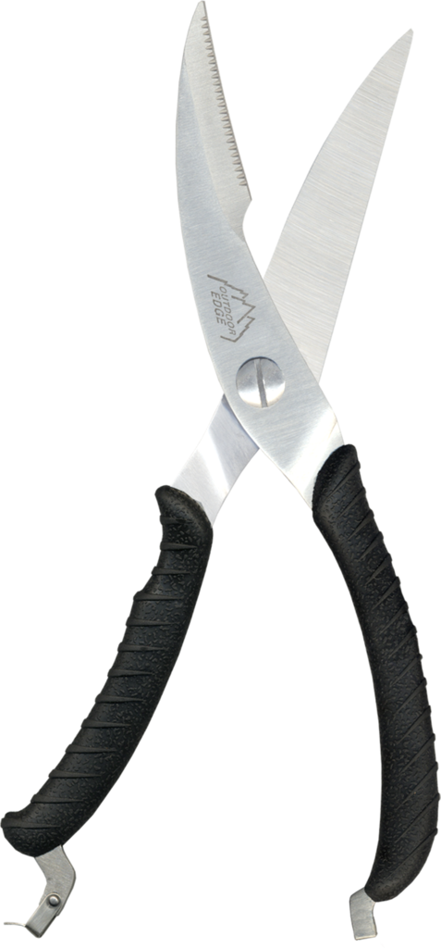
Discussion
Select one material from your table and write down the properties that make it useful for its task.
What are some other uses for this material?
Example:
Metal is used because it is hard and can be sharpened.

Slide 8

Rock, Paper, Scissors
In Rock, Paper, Scissors, students use their hands to represent each item.
Each participant shakes a fist three times and on the third shake forms one of the three shapes with their hand.
If both participants form the same shape it is a draw.
If students form different shapes, the following rules apply:
1. Rock beats scissors
2. Scissors beat paper
3. Paper beats rock
The winner is the first person to win three times.
Notes:
Students play rock, paper scissors for 5 minutes

Slide 9
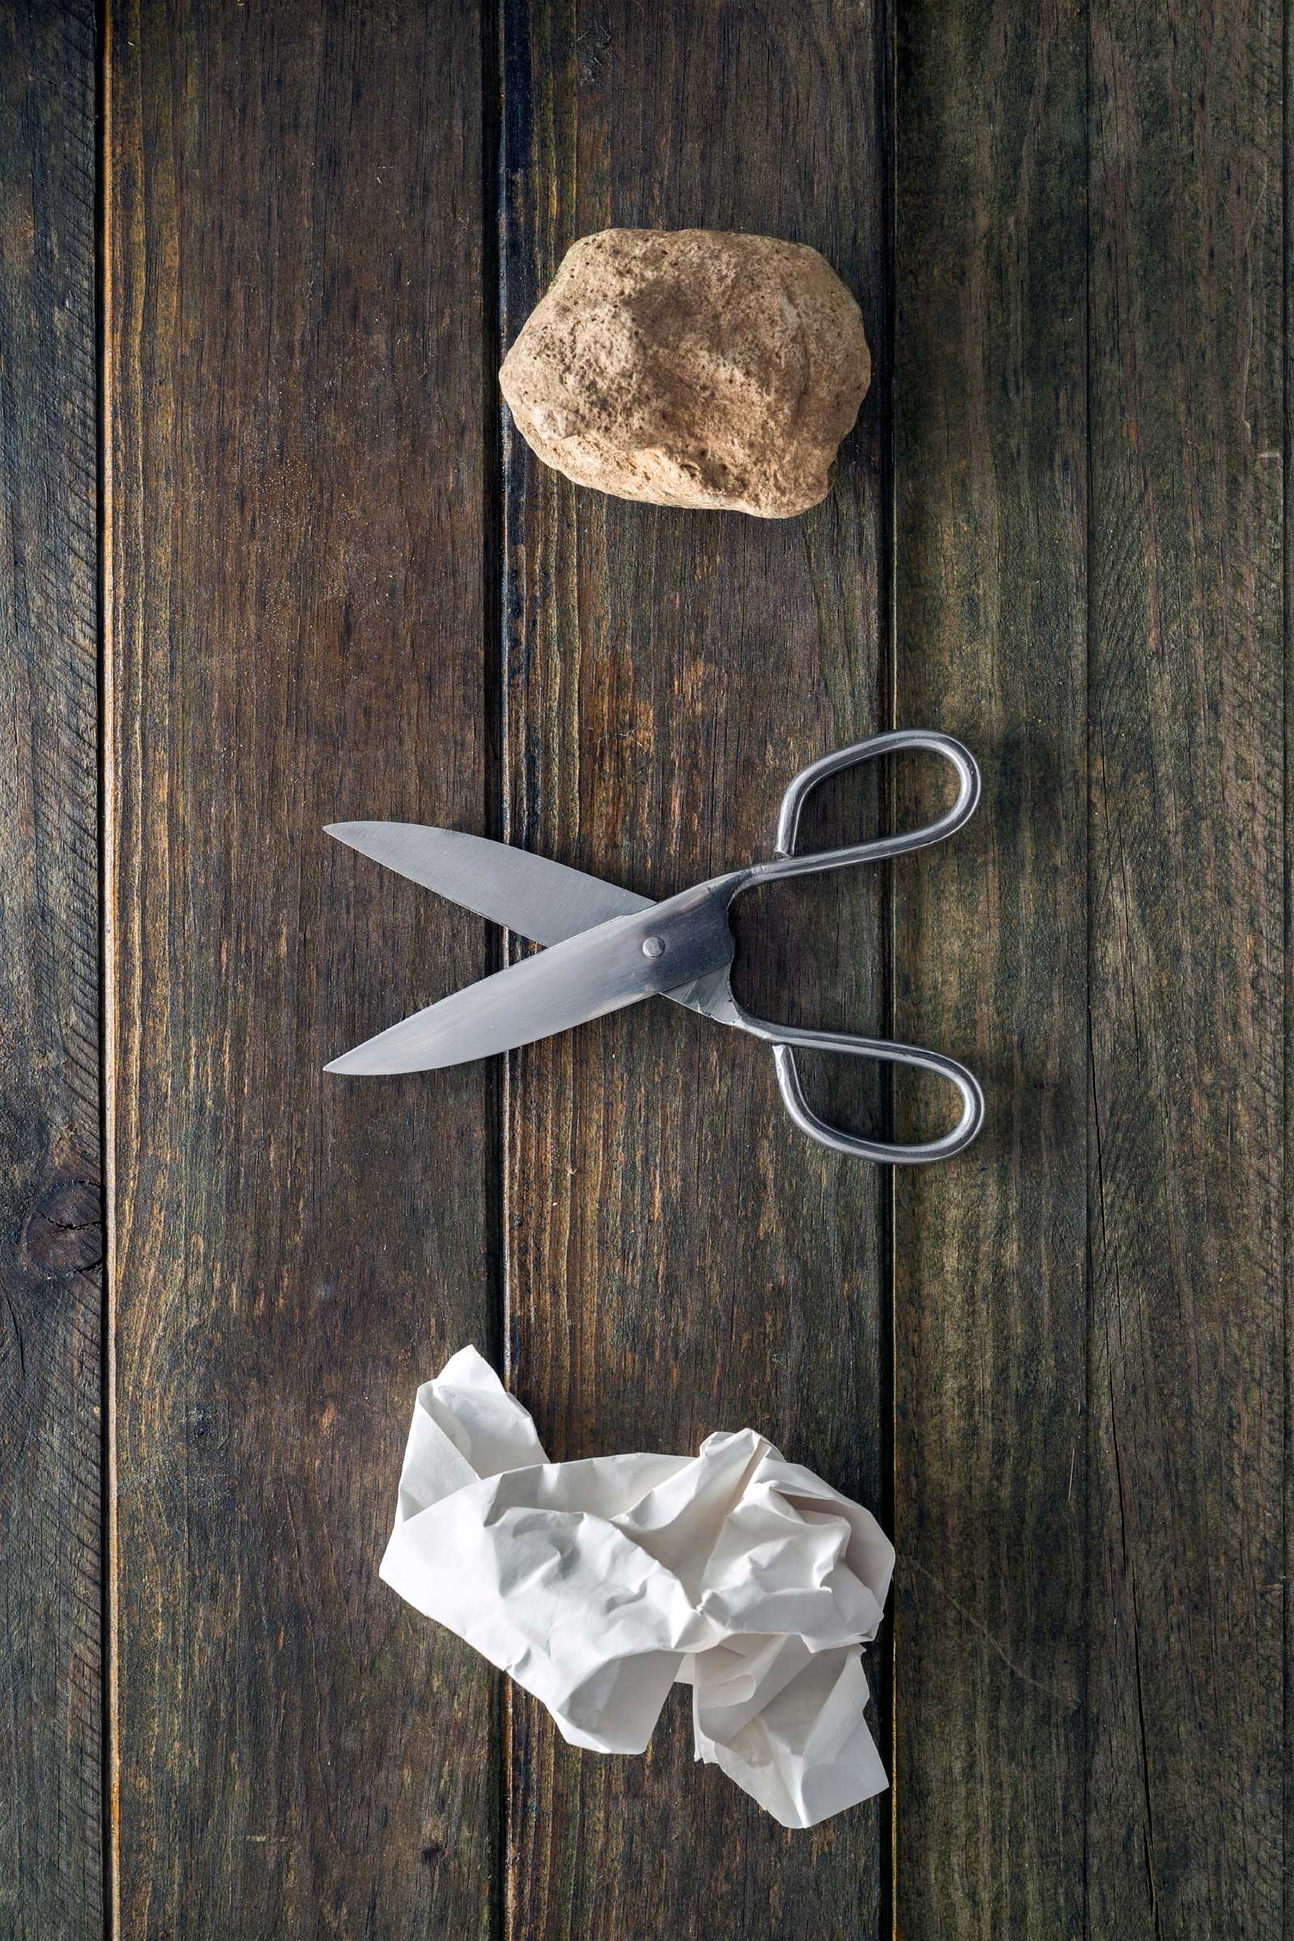
Why we use the materials we do
What are the properties of rock that mean they “beat’ scissors?
What are the properties of scissors mean they “beat” paper?
What are the properties of paper mean it ”beats” rock?
These are physical properties

Slide 10
Answers
1. Rock beats scissors, because rock blunts scissors due to its hardness
2. Scissors beat paper, because scissors cut paper, due to their ability to be sharp and strong
3. Paper beats rock, because paper wraps up rock, due to its thickness, weight, texture, folding endurance, strength and size

Slide 11
Describe the properties of the following:-
Plastic plate
Sock
Teabag
Paper towel
Spoon
Balloon

Slide 12
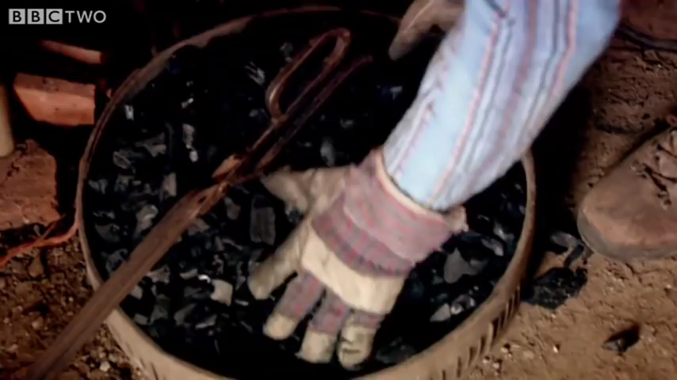

Slide 13
